Slide 1



Business Process Model
and Notation
Notes:
BPMN

Slide 2
Agenda
01
02
03
What is bpmn?
BPMN Basics
Event
04
05
06
Activity
Gateway
Flow
07
08
09
Data
Artifact
Swimlane

Slide 3
Agenda
10
11
12
BPMN Example
QUIZ
conclusion

Slide 4
What is BPMN?

Slide 5
What is BPMN?
Business Process Model and Notation (BPMN) is a graphical representation for specifying business processes in a business process model.
BPMN will provide businesses with the capability of understanding their internal business procedures in a graphical notation and will give organizations the ability to communicate these procedures in a standard manner. Furthermore, the graphical notation will facilitate the understanding of the performance collaborations and business transactions between the organizations. This will ensure that businesses will understand themselves and participants in their business and will enable organizations to adjust to new internal and B2B business circumstances quickly.
Business Process Management Initiative developed BPMN, which has been maintained by the Object Management Group since the two organizations merged in 2005.

Slide 6
BPMN Basics

Slide 7
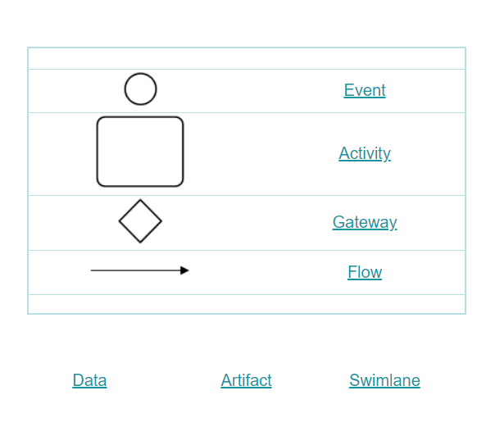
BPMN Basics

Slide 8
Event
Start, Intermediate, End

Slide 9
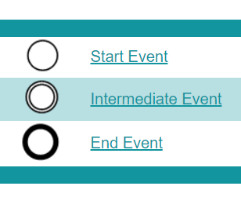
Event

Slide 10
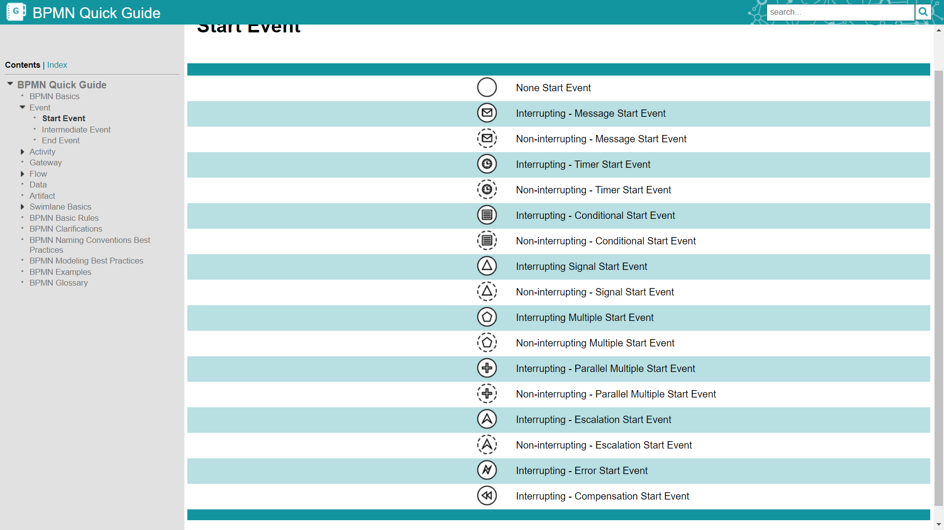
Start Event

Slide 11
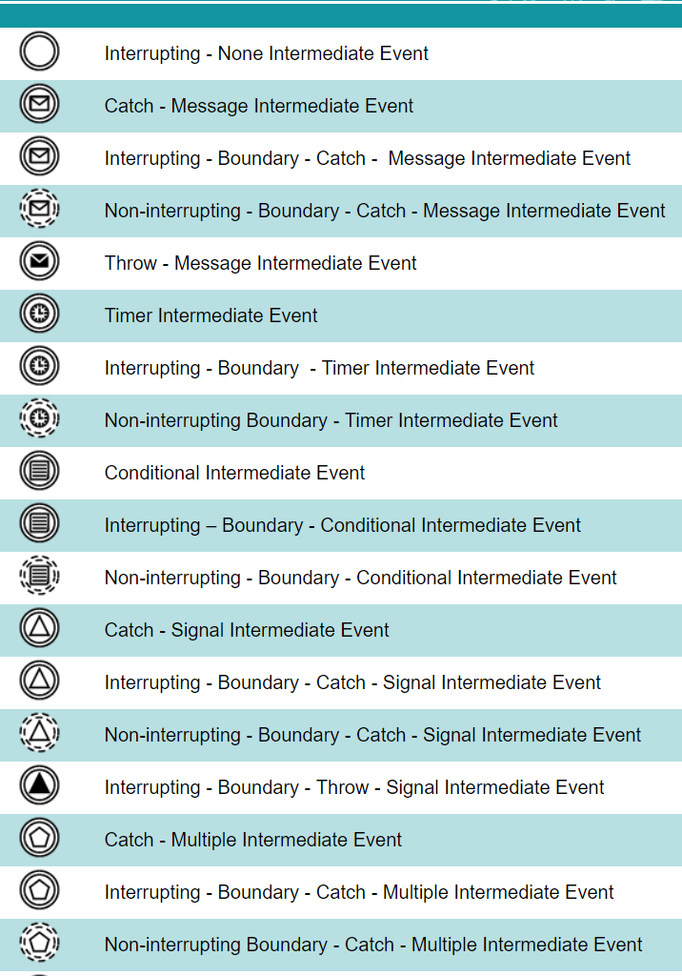
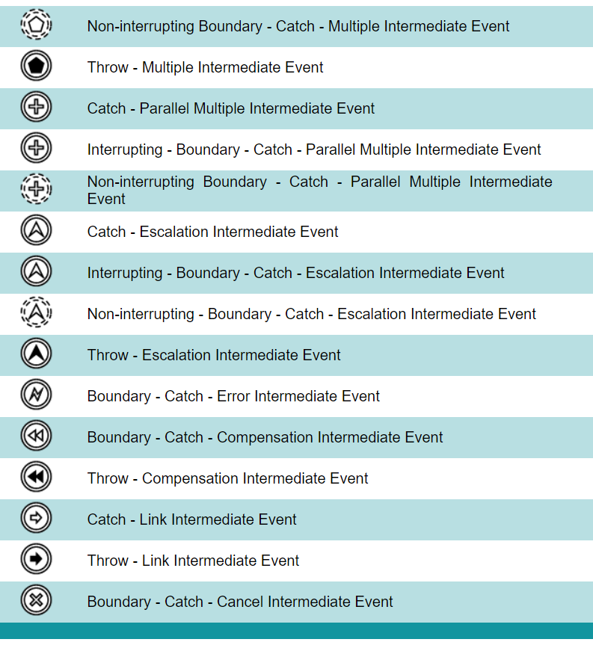
Intermediate Event

Slide 12
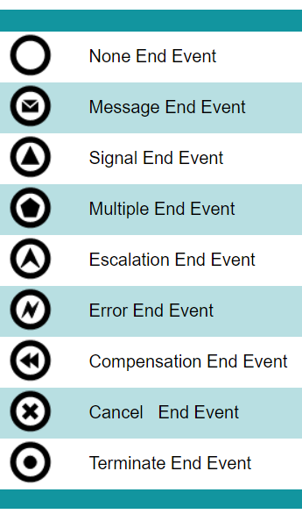
End Event

Slide 13
Activity
Tasks, Sub Process, Adhoc Sub Process, Transaction, Event Sub Process, Call Activity

Slide 14
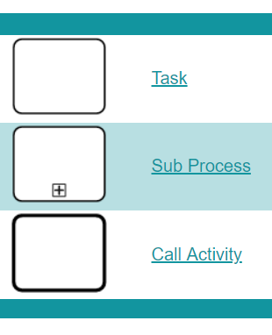
Activity

Slide 15
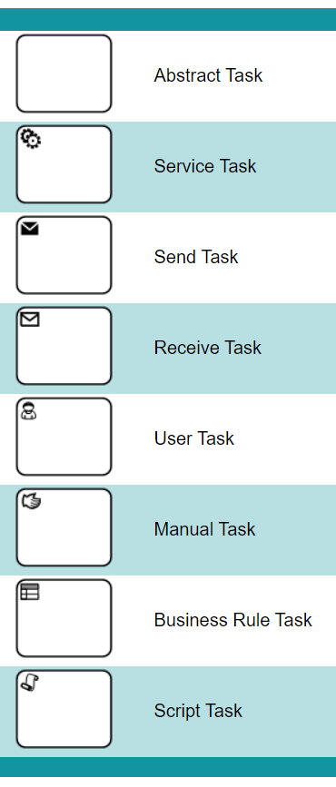
Task

Slide 16
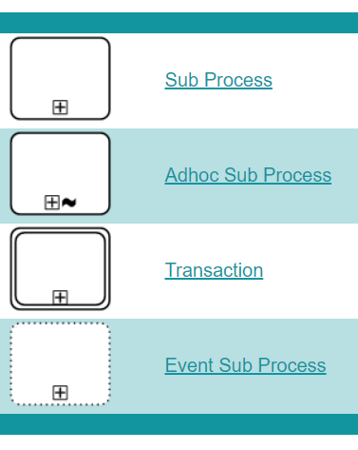
Sub Process

Slide 17
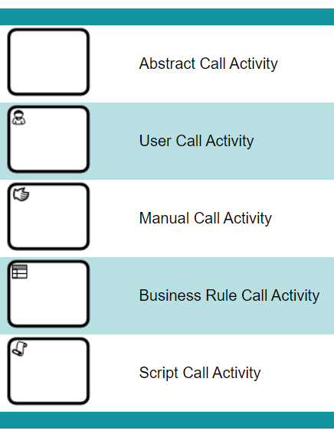
Call Activity

Slide 18
Gateway
Exclusive, Inclusive, Parallel, Event Based, Complex

Slide 19
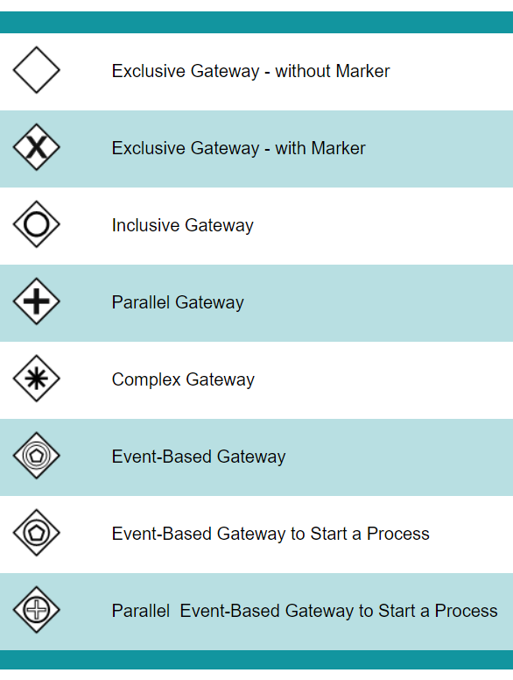
Gateway

Slide 20
Flow
Sequence, Message, Association, Data Association

Slide 21
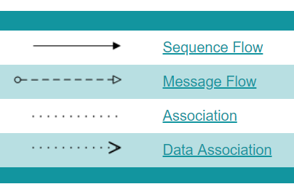
Flow

Slide 22
Data
Input, Output, Store

Slide 23
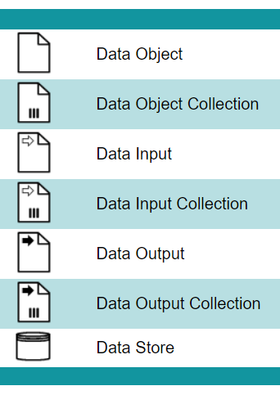
Data

Slide 24
Artifact
Group, Text Annotation

Slide 25
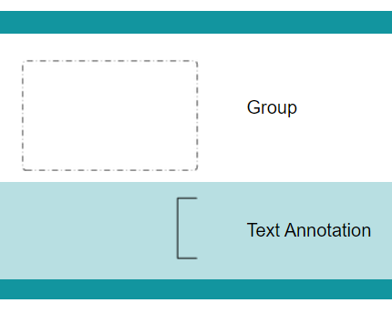
Artifact

Slide 26
Swimlane
Lane, Pool

Slide 27
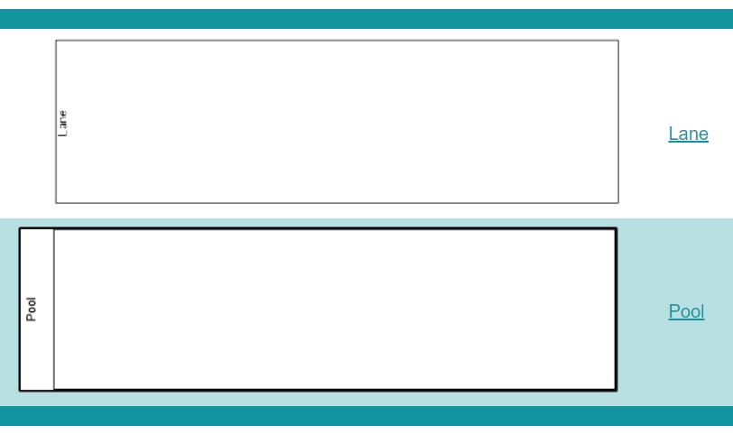
Swimlane

Slide 28
BPMN Example
Process Model

Slide 29
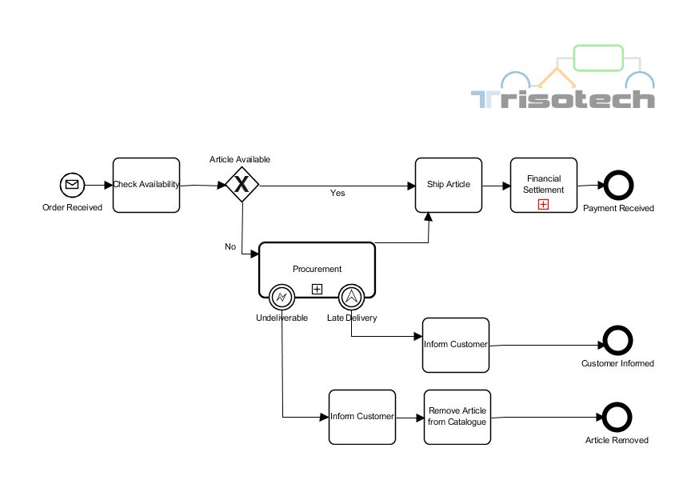
BPMN Example

Slide 30

Quiz
BPMN

Slide 31
Quiz
BPMN Stands for ______________
Business Process Management Notation
Business Process Model and Notation
Business Project Modeling Notation
Business Product Making Notation

Slide 32

Answers
BPMN Stands for ______________
Business Process Management Notation
Business Process Model and Notation
Business Project Modeling Notation
Business Product Making Notation

Slide 33
Quiz
Intermediate Events can occur before start events
True
False

Slide 34
Answers
Intermediate Events can occur before start events
True
False

Slide 35
Conclusion

Slide 36


Summary
In this session, you have learnt:
BPMN
BPMN Basics
Event
Activity
Gateway
Flow
Data
Artifact
Swimlane
BPMN Example

Slide 37

India : +91-7847955955
US : 1-800-216-8930 (TOLL FREE)
support@intellipaat.com
24X7 Chat with our Course Advisor
Notes:
Thank you!

